Slide 1
Capstone Project
EXPLORATORY DATA ANALYSIS(EDA) ON PLAY STORE APP REVIEW DATA BY : GAURAV MAKODE

Slide 2

CONTENT
1) What is Google Play Store .
2) Defining problem statement .
3) Data overview .
4) Exploratory Data Analysis( EDA) .
5) Conclusion .
6) Challenges .

Slide 3
Google Play , also branded as the Google Play Store are formerly Android Market , is a digital distribution service operated and develop by Google . It serves as the official app store for certified devices running on the Android operating system and its derivatives as well as ChromeOS , allowing user to browse and download applications developed with the Android software development kit(SDK) published through Google . Google Play has also served as a digital media store , offering games , music, books , movies, and television programs be.
What is Google Play Store ?

Slide 4
Problem Statements
What is the ratio of number of Paid apps and Free apps ?
Top categories on Google Playstore ?
Most number of installed App Category ?
Average rating of the apps
What are the Top 10 installed apps in any category ?
Distribution of apps based on its size
Android version based on each category
Top apps that are of free type.
Percentage of Review Sentiments
Apps with the highest number of positive reviews
Apps with the highest number of negative reviews.
Is sentiment_subjectivity proportional to sentiment_polarity ?

Slide 5
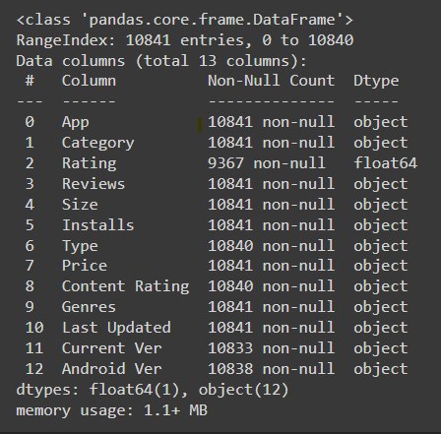
Data Overview
1) Play Store Data: This data contains the property and characteristics of each apps.
App: Name of the app
Category: Category of the app. Some examples are: ART_AND_DESIGN, FINANCE, COMICS, BEAUTY etc.
Rating: The current average rating (out of 5) of the app on Google Play
Reviews: Number of user reviews given on the app
Size: Size of the app in MB (megabytes)
Installs: Number of times the app was downloaded from Google Play
Type: Whether the app is paid or free

Slide 6
Data Overview
Price: Price of the app in US$
Content Rating: A content rating (also known as maturity rating) rates the suitability of TV broadcasts, movies, comic books, or video games to its audience.To show which age group is suitable to view media and entertainment.
Genres: A category of artistic, musical, or literary composition characterized by a particular style, form, or content
Last Updated: Date on which the app was last updated on Google Play
Current Ver: Current Version means a version of the software that is currently being supported by its publisher.
Android Ver: Android versions (codenames) are used to describe the various updates for the open source Android mobile operating system

Slide 7
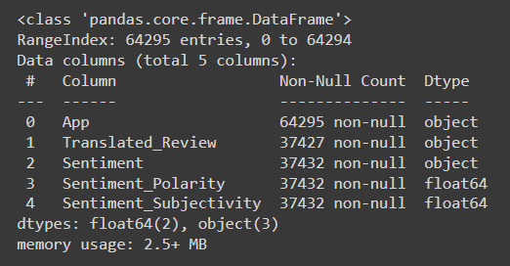
Data Overview
2) User Reviews : This data includes reviews based on users personal experience, this can be converted in variable and can be used for analysis
App: Name of the app on which the user review was provided. Matches the App column of the play_store_data.csv file
Translated Review: The pre-processed user review text.
Sentiment: Sentiment category of the user review - Positive, Negative or Neutral.
Sentiment Polarity: Sentiment score of the user review. It lies between [-1,1]. A higher score denotes a more positive sentiment.

Slide 8

Exploratory Data Analysis( EDA)

Slide 9
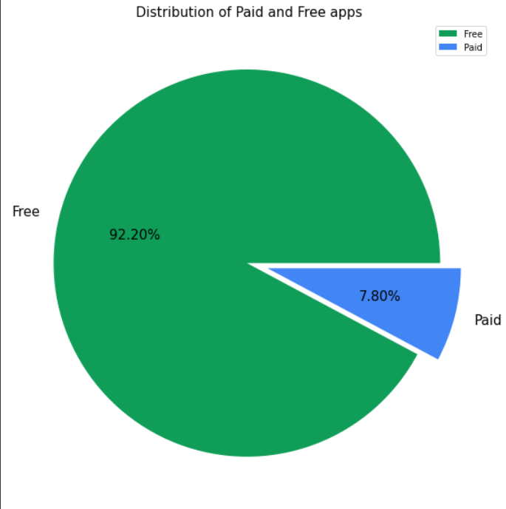
EDA
1. What is the ratio of number of Paid apps and Free apps
Free apps are dominating the market by huge percentage that is 92.6%
There are very low Percentage of paid apps in Play store which is 7.4%

Slide 10
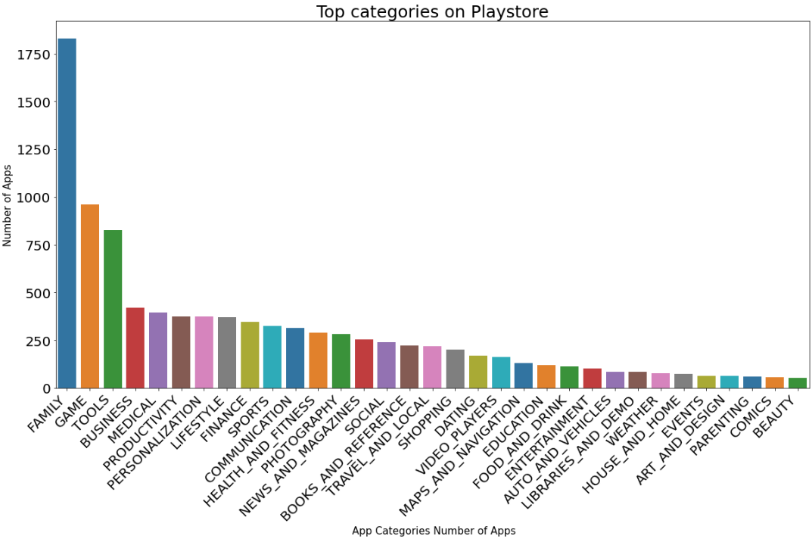
EDA(continued)
There are more numbers of app in categories like Family , Game , Tools.
Least no. of app are there is categories like events, art and design, parenting, comics and beauty.

Slide 11
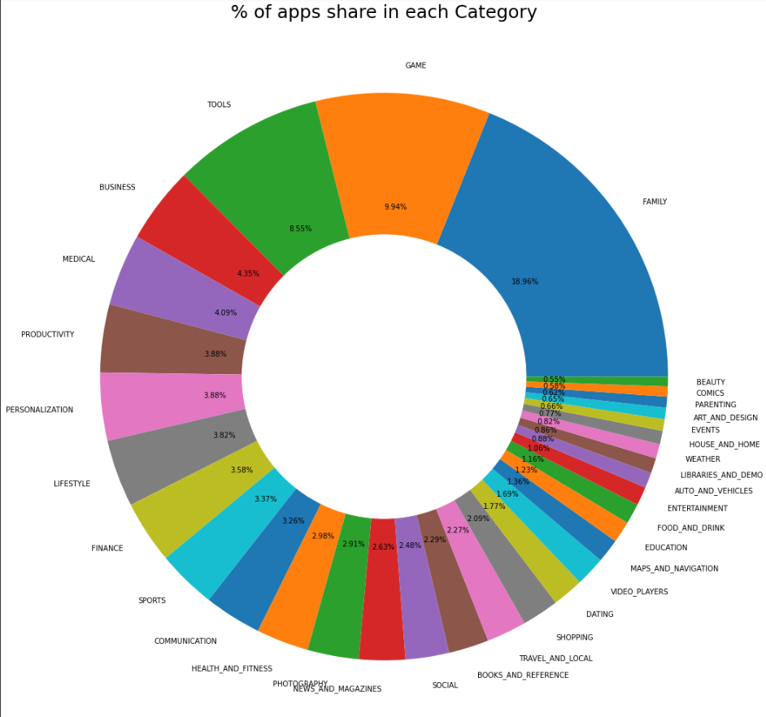
EDA(continued)
Family has more percentage of app share with 18.96%
Least percentage of share is of Beauty with only 0.55%

Slide 12
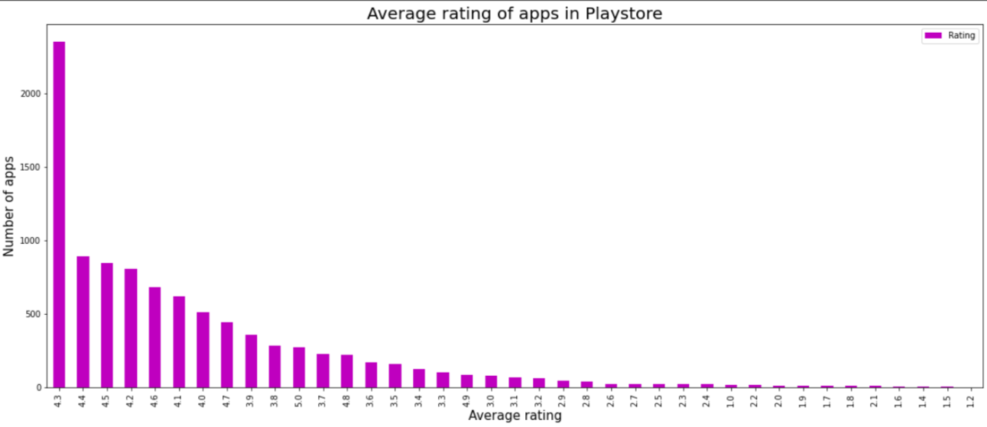
EDA(continued)
There are more No. of app rated 4.3.

Slide 13
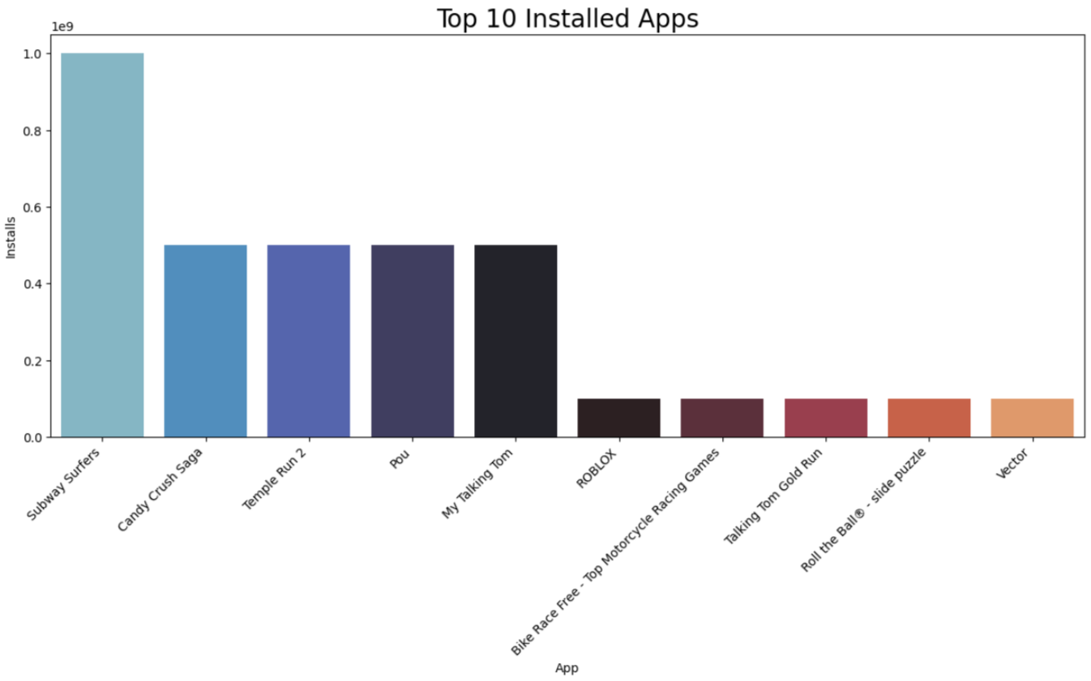
EDA(continued)
Subway Surfer has the highest no. of install.
And next top 4 app has almost equal no. of install.

Slide 14
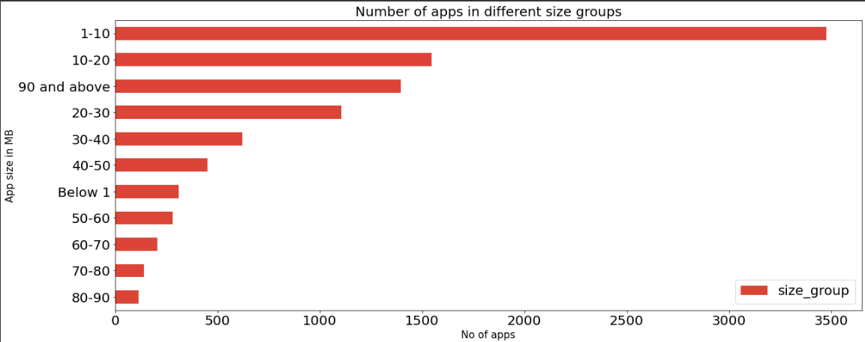
EDA(continued)
There are more no. of app installed which size is between 1 to 10 mb .

Slide 15
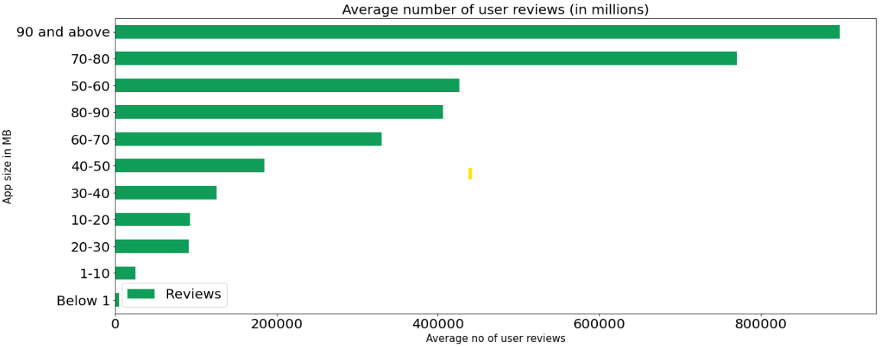
EDA(continued)
Apps of size 90 mb and above has more no. of user reviews .

Slide 16
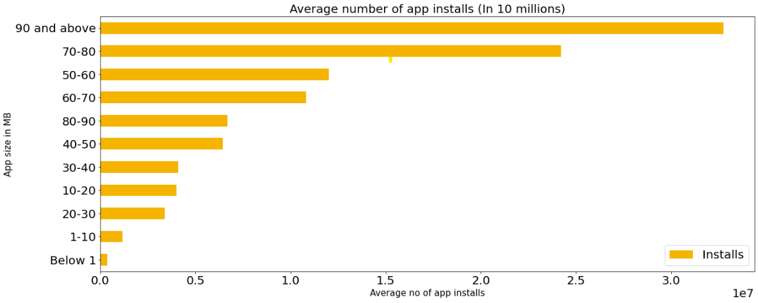
EDA(continued)
There are more no. of apps install whose size is 90mb or greater than 90mb .

Slide 17
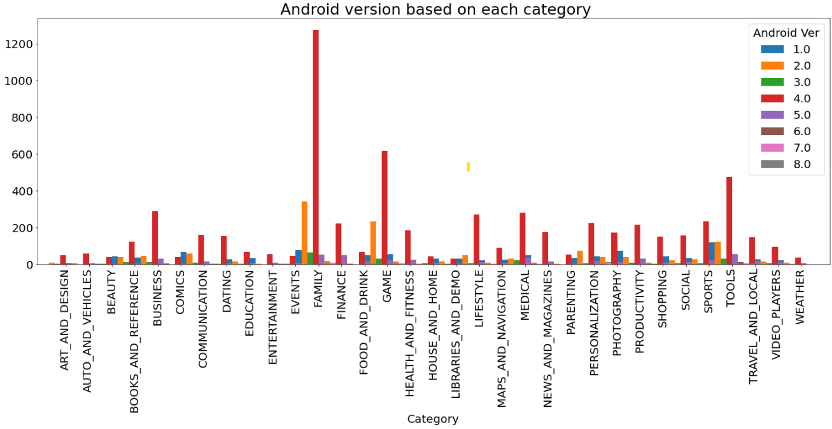
EDA(continued)
In every category largest no. of apps are made on Android version 4.0 .

Slide 18
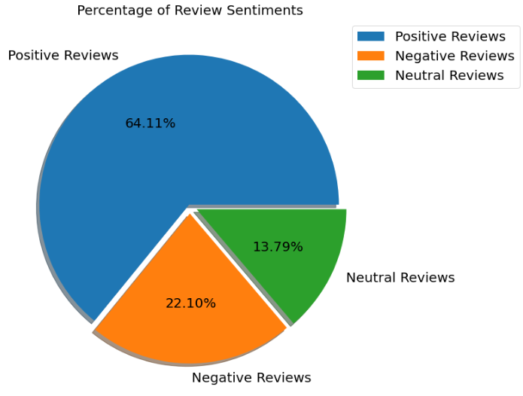
EDA(continued)
There are more no. of percentage of positive reviews which is 64.11% .
There are 13.79% of neutral reviews .
There are 22.10% of negative reviews .

Slide 19
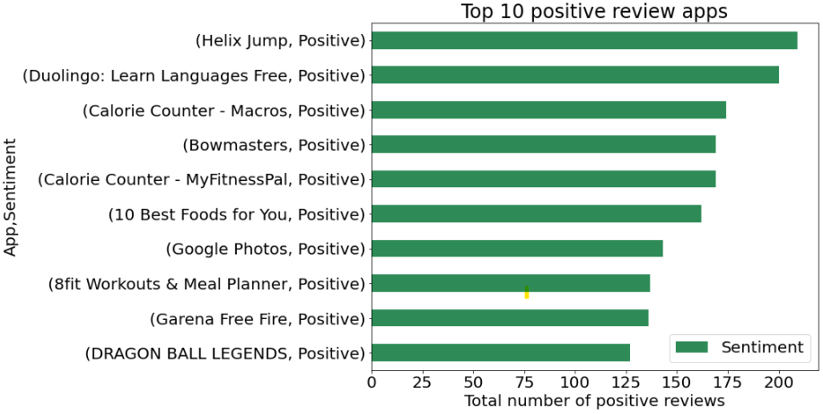
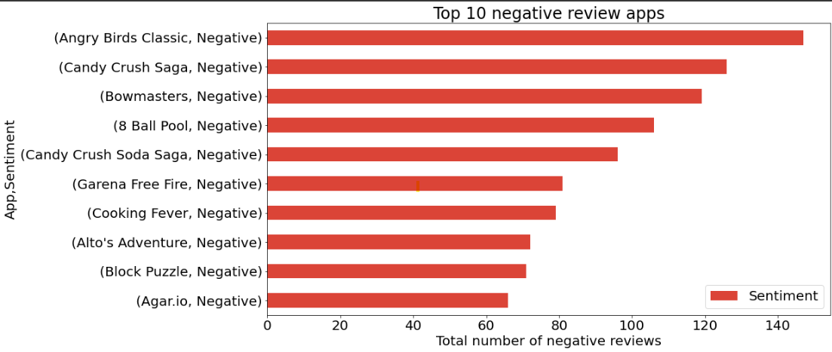
EDA(continued)

Slide 20
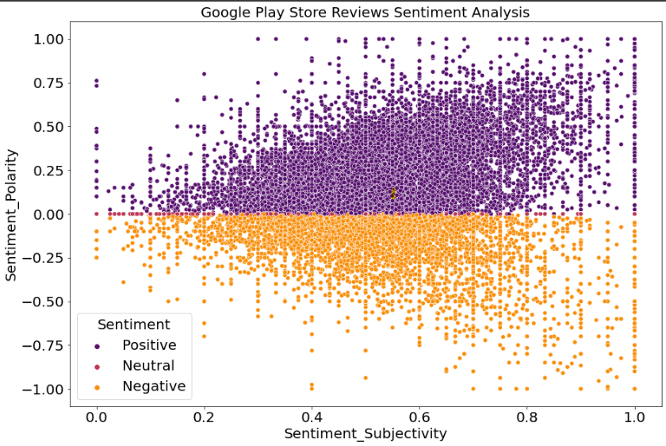
EDA(continued)

Slide 21
Conclusion
Average rating of (active) apps on Google Play Store is 4.17.
Thus, a paid app that is higher in size may not perform well in the market.
Users prefer to pay for apps that are light-weighted
Most of the top rated apps are optimally sized between ~2MB to ~40MB - neither too light nor too heavy.
Most of the top rated apps are optimally priced between ~1to 30 - neither too cheap nor too expensive.
Users tend to download a given app more if it has been reviewed by a large number of people.
Health and Fitness apps receive more than 85% positive reviews.
Game and Social apps receive mixed feedback 50% positive and 50% negative

Slide 22
Challenges
Major challenge was data cleaning .
13.60% of reviews were NaN values, and even after merging both the dataframes , we could not infer much in order to fill them. Thus we had to drop them.
Computation Time .

Slide 23
THANK YOU

